Slide 1
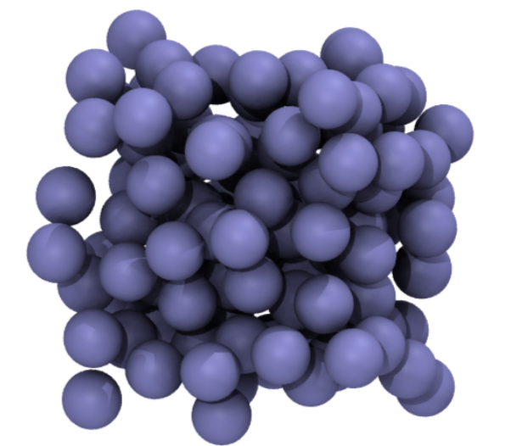
Introduction to Molecular Simulations in Python
MiCM Summer 2025 Workshop Series
Instructor: Meghana Munipalle
meghana.munipalle@mail.mcgill.ca

Slide 2
Notes:
The McGill initiative on Computational Medicine was formed in 2017 and aims to deliver inter-disciplinary research programs and empower the use of data in health research and health care delivery
Located at the Genome Center
They have a newsletter were you can subscribe to
more info on the web site

Slide 3
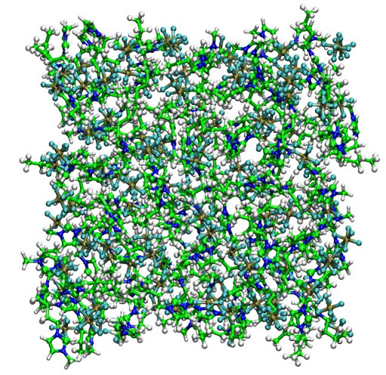
Overview
About me!
Introduction to Molecular Simulations
Molecular Dynamics (MD)
Basics
Hands-on Python exercises
Monte Carlo (MC)
Basics
Hands-on Python exercises
Analysis

Slide 4
Intro to Molecular Simulations

Slide 5
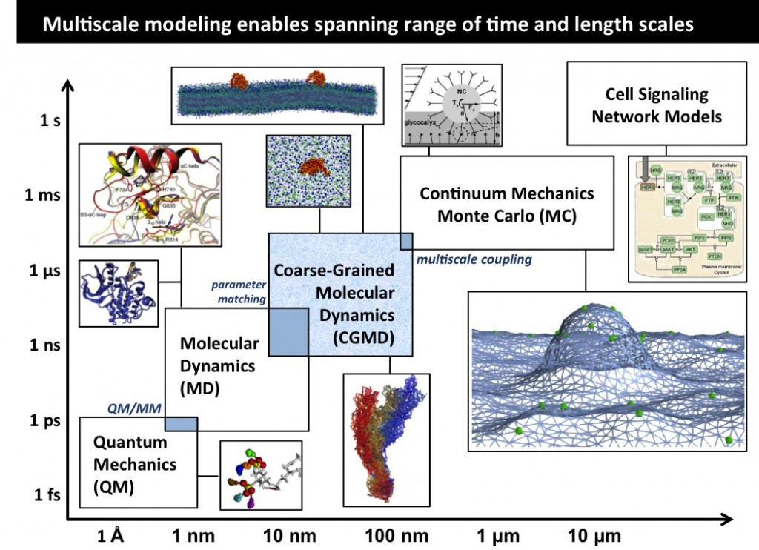
Computational simulations in biology
What we’re interested in!
Radhakrishnan Lab, University of Pennsylvania (https://fling.seas.upenn.edu/~biophys/dynamic/wordpress/?page_id=51)
Notes:
When we want to find something out in the natural sciences at a very basic (molecular level), we’re kind of forced to use equations that we can’t solve exactly on paper unless in very simple cases (like no more than two interacting bodies) but so much of biology deals with a lot more interacting molecules than that
Before computer simulations- the main way to predict the properties of some molecular substance is to use an approximate theory of that specific material (e.g. VDW for dense gases, something for electrolytes) but we don’t have approximate theories for more complex substances
So we need a way to get to an “exact” solution to these without having to know approximate theories for that material
This is where molecular simulation comes in

Slide 6
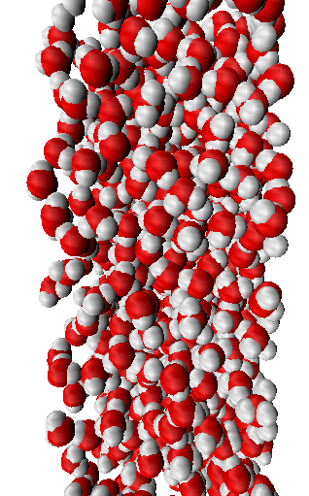
What is a molecular simulation?
Simulate the interaction between atoms/particles to understand the properties of materials
Many applications: physics, biology, chemistry, engineering
Small-molecule drug discovery
Protein structure & dynamics
Materials engineering
6

Slide 7
What is a molecular simulation?
Simulate the interaction between atoms/particles to understand the properties of materials
Many applications: physics, biology, chemistry, engineering
Small-molecule drug discovery
Protein structure & dynamics
Materials engineering
7

Slide 8
What questions can it answer?
How closely packed are those particles typically?
What is the distribution for the position of those particles?
How do those properties change when varying the pressure? density?
What would be the dynamics of particles in specific environmental conditions?
What will be the equilibrium concentrations of molecules in a beaker?
and much much more!
8

Slide 9
Foundation: statistical mech (but simple)
For any model, at some point we need to be able to validate using experimental data
In a computer simulation, you could measure the instantaneous positions and velocities on every single atom in liquid water, for example… but what does this actually mean?
You can’t measure this in a real experiment
So, what we actually want out of our simulations (that’s comparable to something we can measure physically) are averages
9

Slide 10
Foundation: The ergodic theorem
The time average of one property in a system of many particles is equal to its ensemble (space) average
Stat mech tells us that if we want to calculate something like density, we look at its average over all possible microstates (static configurations). This is an ensemble average
We assume that with enough time, a system would sample all of these ensembles, and the time average of the density would be the same as its ensemble average
*It doesn’t always hold up IRL, but we have to assume it in order to use MD and MC simulations!
10

Slide 11
Foundation: The ergodic theorem
Time average = ensemble average
Molecular Dynamics
Monte Carlo
11

Slide 12
MD vs. MC
Complexity of the desired molecule(s)
Dynamic vs. static properties
Viscosity vs. pressure, density, structures, etc.
Computational time
MC is one particle at a time, vs. MD can be parallelized
12
Notes:
Anything to do with time evolution, you can’t use MC

Slide 13
Molecular Dynamics

Slide 14
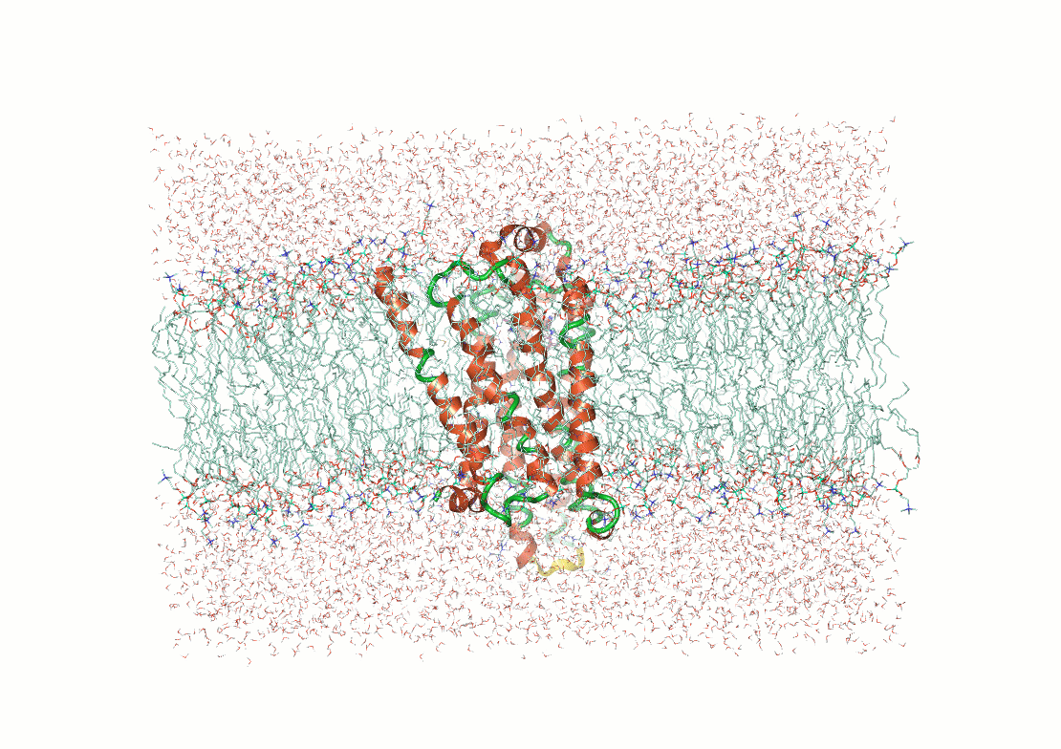
MD: the basic idea
Mimic what atoms do IRL, following Newton’s Laws of motion and a potential energy function
Potential energy function: computes the forces on each atom
Newton’s Laws: move the atoms based on the forces
14

Slide 15
MD: The basic idea
Initialize
Calculate forces
Compute final quantities
Move particles
Repeat as many times as desired*
Start MD loop
End MD loop
This time step is usually 2 fs
*Time length depends on the system; + we always want to reach an equilibrium before we start measuring anything

Slide 16
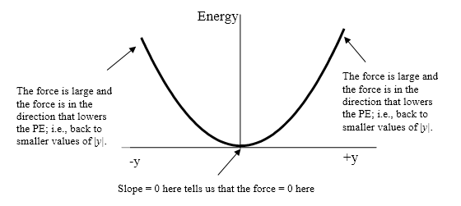
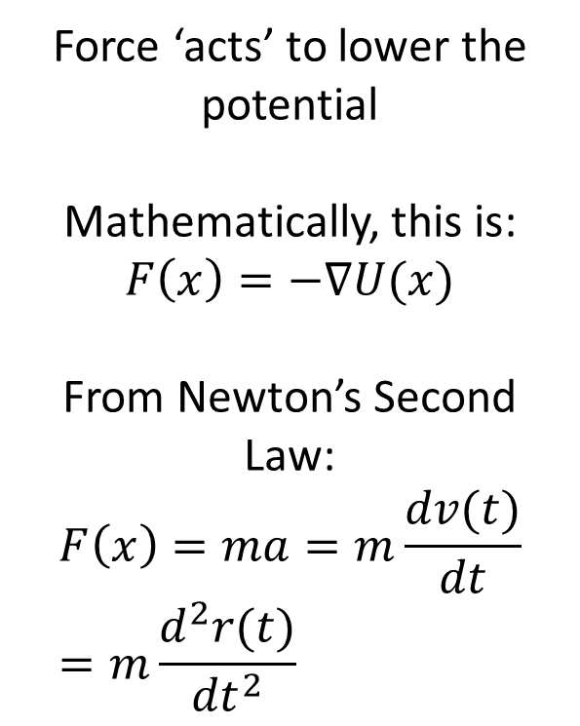
Force & potential energy
Force ‘acts’ to lower the potential
Mathematically, this is:
$$F\left(x\right)=−∇U(x)$$
From Newton’s Second Law:
$$F\left(x\right)=ma=m\frac{dv(t)}{dt}=m\frac{d^{2}r(t)}{{dt}^{2}}$$
Spring-mass system
This is what connects the potential energy (i.e. “force field”) to the position
16
Notes:
- could use this same strategy to quite easily solve & code a 1-body problem (something falling from a certain height) or a 2-3 body problem (things orbiting each other

Slide 17
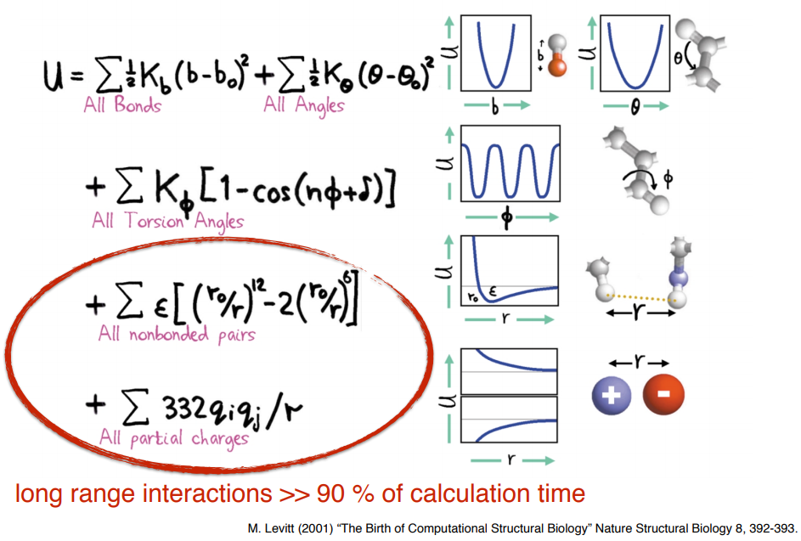
Potential function: molecular mechanics
17

Slide 18
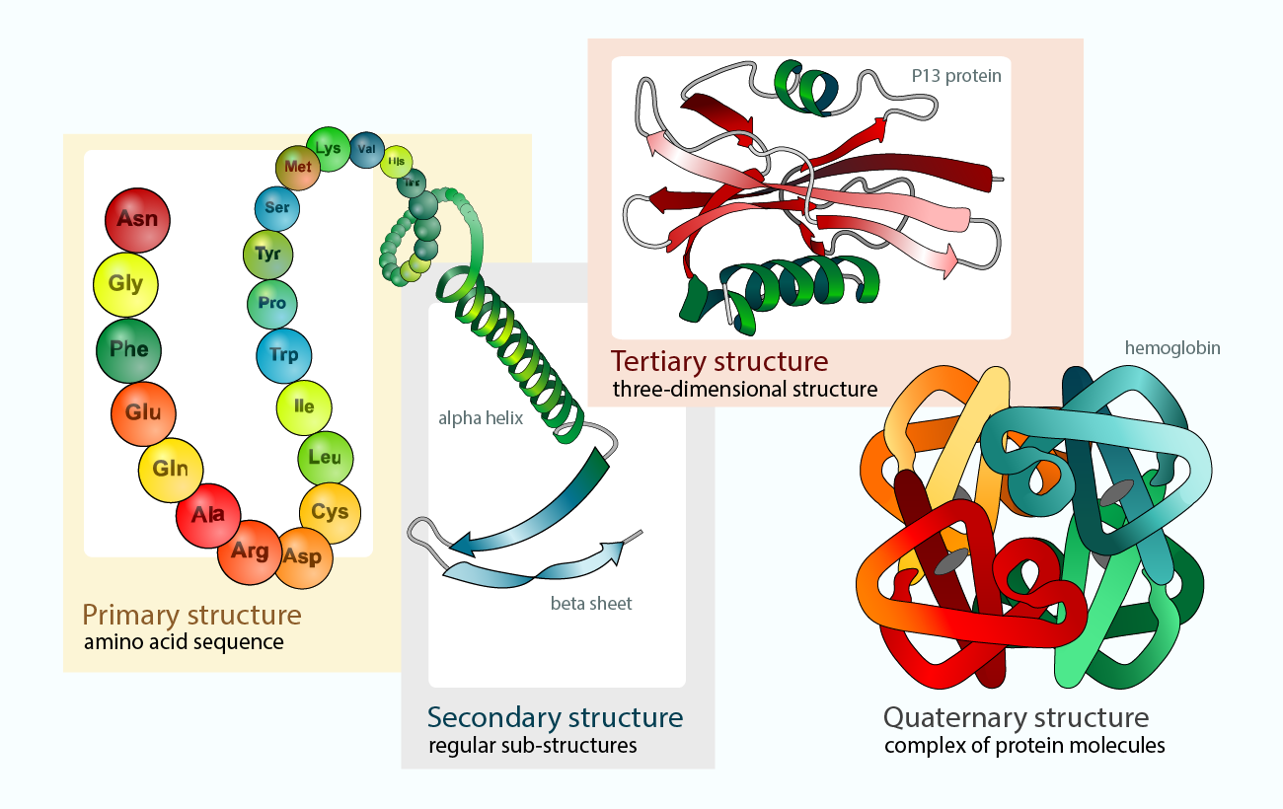
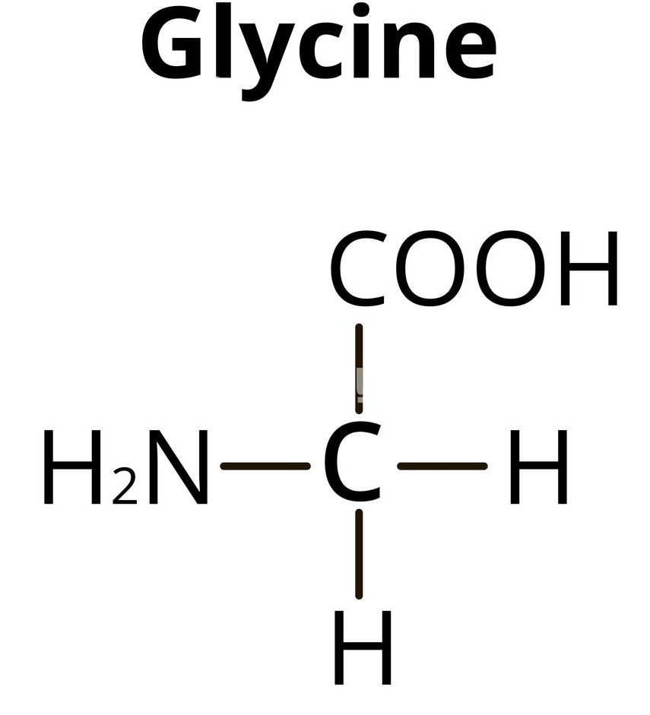
Proteins
18
Notes:
Proteins are a type of macromolecule that basically ‘act on’ most other biological molecular. Includes enzymes (drives chemical reactions), cell signaling, they help bind smaller molecules and transport them throughout the body (like hemoglobin), they make up very important structures in the body like anything that is composed of collagen, keratin, elastin, they function in muscle contraction (myosin is an example) and maybe most importantly, the folding process/structural issues/mutations contribute to a lot of diseases

Slide 19
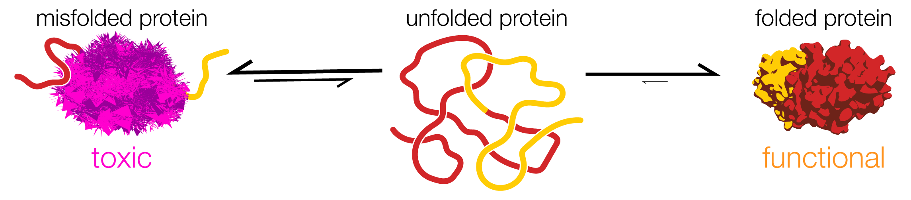
Proteins
This is what normally happens
(driven by atomic interactions)
Folded structure is tied very closely to function
19

Slide 20
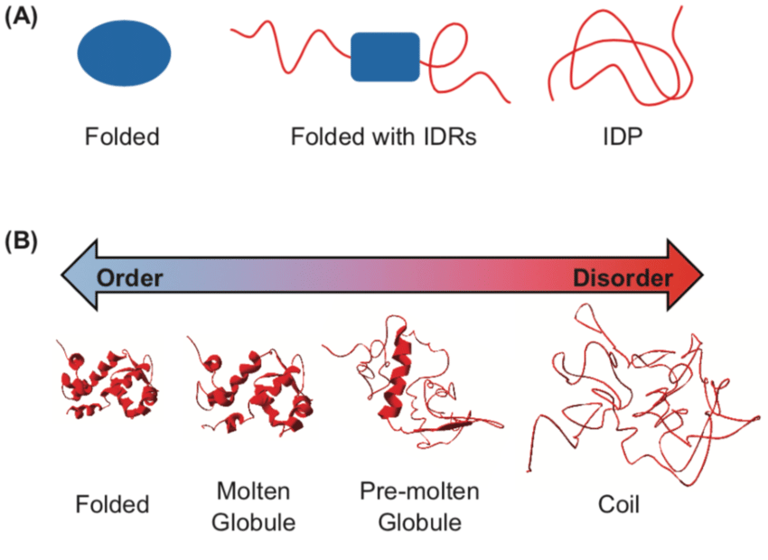
Proteins: intrinsically disordered proteins (IDPs)
Some proteins just don’t fold!

Slide 21
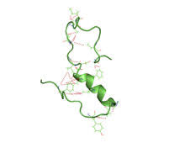
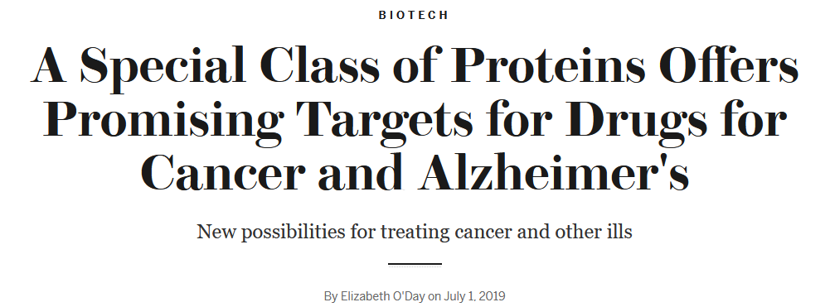
Proteins: intrinsically disordered proteins (IDPs)
Amyloid beta
Notes:
Studying treatments for these include a lot of data on how and what can bind to these IDPs or IDRs

Slide 22
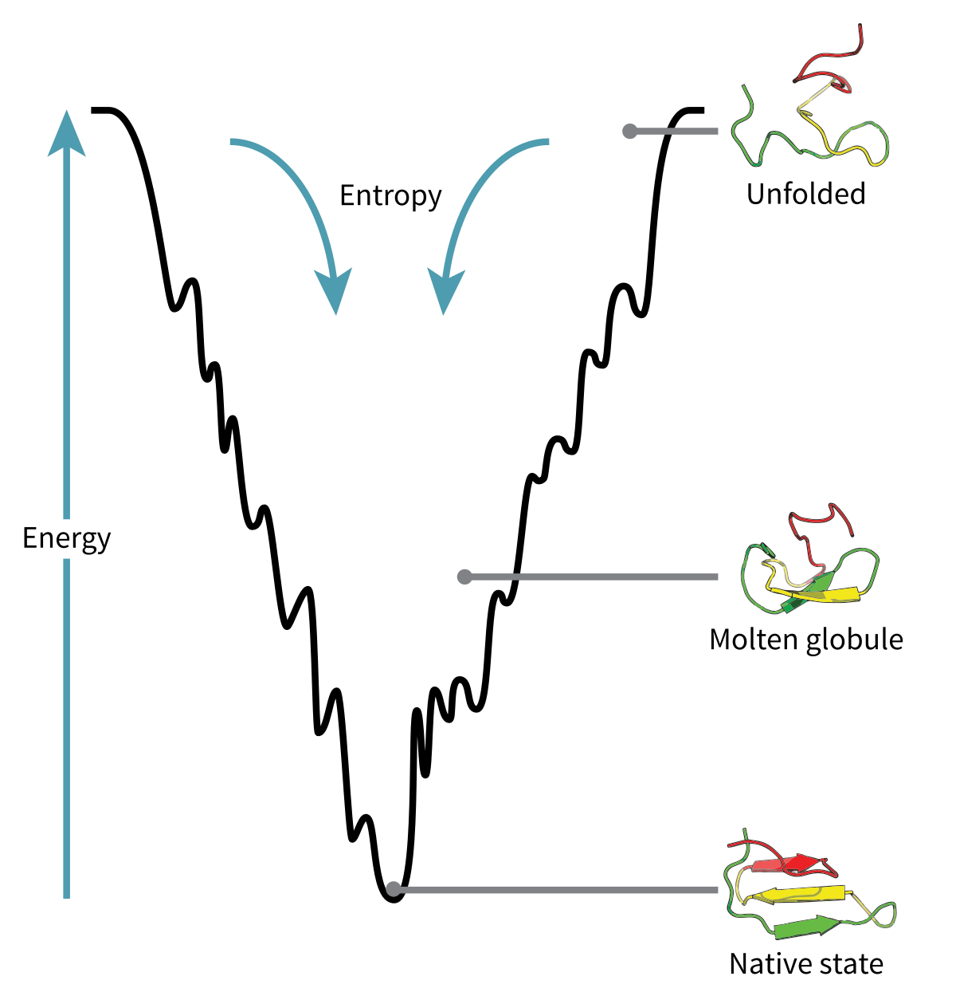
Protein folding
How does a linear chain of amino acids get to a functional, folded 3D structure?
Tends towards a lower energy state- bonds form and the protein becomes more compact
Notes:
Studying treatments for these include a lot of data on how and what can bind to these IDPs or IDRs

Slide 23
Protein folding
Energy landscapes can be complex!
Amino acid chains have a lot of flexibility and could move/fold in many ways- how does the protein ‘know’?
Often has to explore the energy landscape
Notes:
Imagine it as a ball rolling- the ball doesn’t ‘know’ to go to the bottom, but as it rolls, it will tend towards the minimum because of gravity

Slide 24
Energy vs. force
Potential energy function = ‘force field’

Slide 25
MD: The basic idea
Initialize
Calculate forces
Compute final quantities
Move particles
Repeat as many times as desired*
Start MD loop
End MD loop
This time step is usually 2 fs

Slide 26

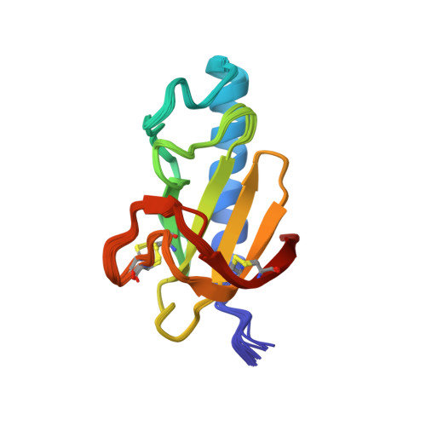
MD: initialization
Initial coordinates
Stored in a PDB file or topology file
Other initial parameters- temperature, amount of time to run

Slide 27
MD: The basic idea
Initialize
Calculate forces
Compute final quantities
Move particles
Repeat as many times as desired*
Start MD loop
End MD loop
This time step is usually 2 fs

Slide 28
MD: Forces & Motion
Choose a force field
Defines the parameters in the potential function
Many different ones that have been refined over the years
Choose an integration method
Algorithm for solving the equations of motion
Specify any cutoff values
Long range interactions are quite expensive.. We can specify a certain distance beyond which we ignore them

Slide 29
MD: Forces & Motion
Have to apply periodic boundary conditions
Can’t actually simulate an infinite system, so we approximate it
The part in the middle, the unit cell, is simulated, and when an atom leaves these boundaries, it reappears on the other side

Slide 30
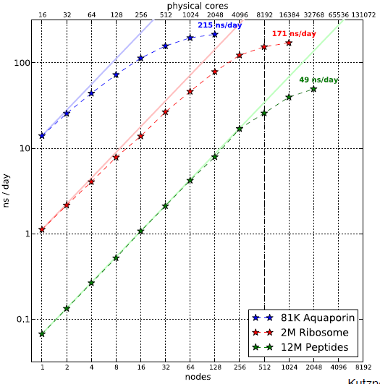
MD: Time
In research, timescales are often nanoseconds and of much bigger systems
Kutzner et al. “SUPERMUC Extreme Scaling Workshop”

Slide 31
MD: Time
Erik Lindahl “Molecular Modelling of Proteins” 2013

Slide 32
Monte Carlo Molecular Simulations

Slide 33
Foundation: The ergodic theorem
Time average = ensemble average
Molecular Dynamics
Monte Carlo
33

Slide 34
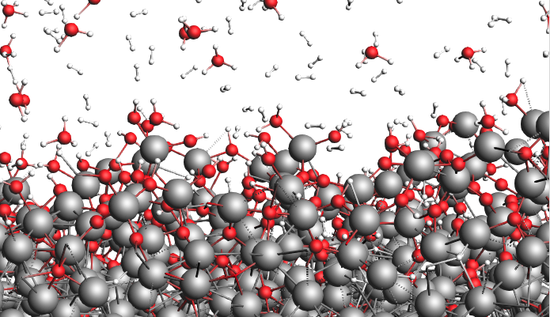
The monte carlo method
Instead of dynamics (a time average),we generate many states according to a Boltzmann distribution
MD: uses forces to explore the energy landscape
MC: randomly explores the energy landscape

Slide 35
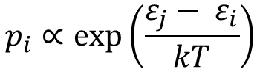
Boltzmann distribution
A probability distribution (like normal or uniform distributions) that describes the probability of the system being in a certain state as a function of energy and temperature
States with lower energy → higher probability of being occupied
$$p_{i}∝\exp\left(\frac{ε_{j}− ε_{i}}{kT}\right)$$

Slide 36
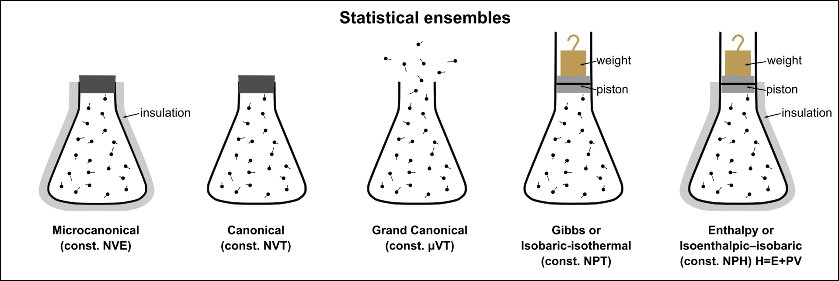
Ensembles
* Also applies to MD!
Notes:
- we’ve established that this is an ensemble average
- we can create different types of ensembles based on what we hold constant, even if the atoms/molecules for example keep moving

Slide 37
Monte carlo for molecular simulations
Since they don’t consider evolution over time, not applicable to every single situation
BUT chemical/physical/thermodynamic properties might be much more efficiently or accurately calculated in MC than in MD
Useful for simulations of liquids, gases, solvation processes, lattices, etc.

Slide 38
Monte carlo for molecular simulations
The Metropolis algorithm
1. Specify the initial coordinates.
2. Pick a particle at random to move & move it, generating a new set of coordinates
3. Calculate the change in potential energy between the configurations
4. a) If the change is negative (i.e., energy decreased) accept the new configuration & go to step 2 again
b) If the change is positive (i.e., energy increased) run a probability test:
i) Pick a random number
ii) If this number is less than the Boltzmann probability, accept the move
iii) If this number is more than the Boltzmann probability, reject the move
iv) Go to step 2 again

Slide 39
Other analysis

Slide 40
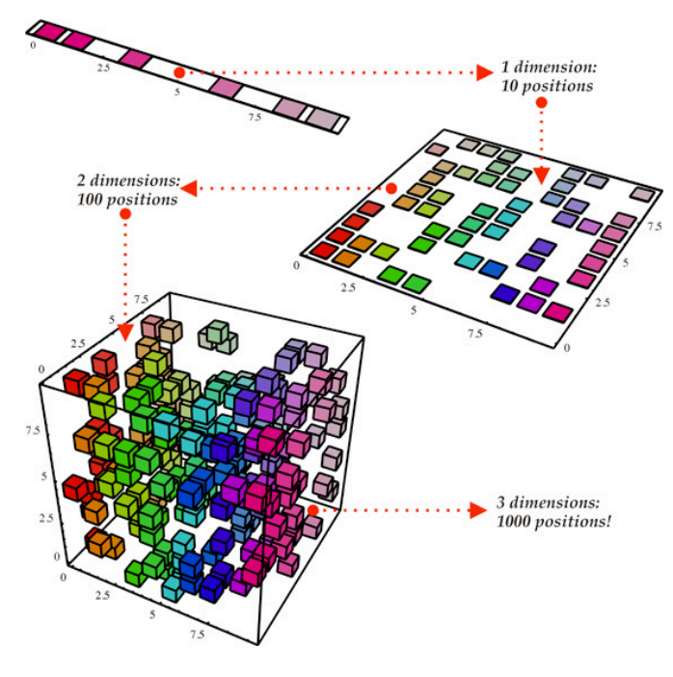
Machine learning
Useful for dealing with MD simulation data, because there’s so much information
Notes:
- dimensionality reduction & clustering techniques from machine learning can tell us a lot about protein structure from our MD simulations
-

Slide 41
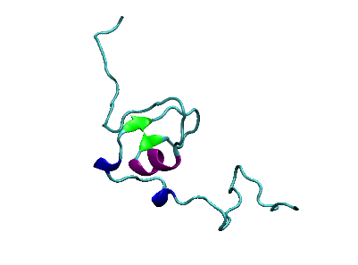
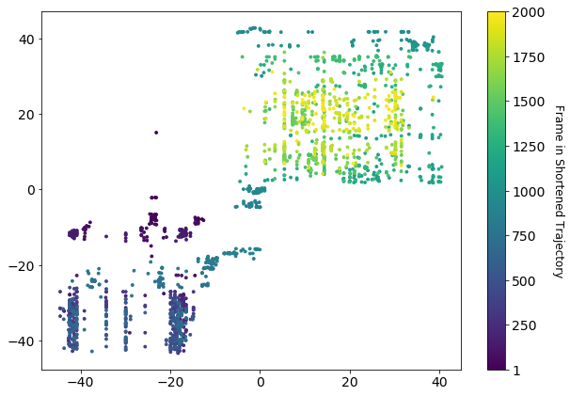
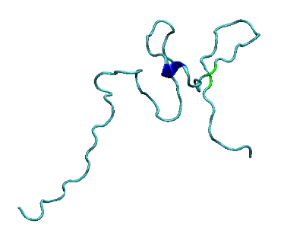
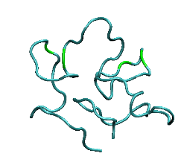
Machine learning
C
Representative structures at different “stages” of the trajectory: A, B, C
A
B
Notes:
-

Slide 42
What next?
MD in Python:
openmm for running simulations
pysimm for developing/optimizing your workflow (i.e. handling all those parameters
mdanalysis, pytraj, mdtraj for handling trajectories and analysis
MC in Python:
Not too hard to write short routines yourself!
dlmontepython for analysis of MC simulations
py-MCMD for workflow/analysis of hybrid MD-MC simulations
Notes:
-

Slide 43

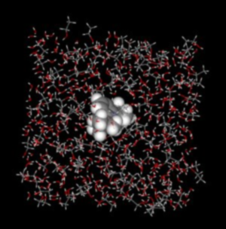


What next?
MD:
MC:
BOSS
Towhee
Notes:
-

Slide 44
Thanks for coming!
MiCM Summer 2025 Workshop Series
Instructor: Meghana Munipalle
meghana.munipalle@mail.mcgill.ca

